Slide 1
Gaussian
CS 109
Lecture 10
April 18th, 2016

Slide 2
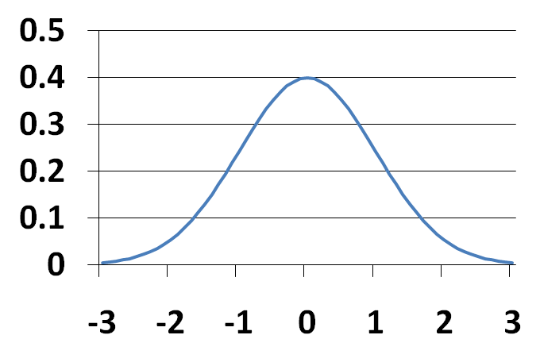
The Normal Distribution
X is a Normal Random Variable: X ~ N(μ, σ ²)
Probability Density Function (PDF):
Also called “Gaussian”
Note: f(x) is symmetric about μ
Common for natural phenomena: heights, weights, etc.
Often results from the sum of multiple variables
Noise
μ

Slide 3


Four Prototypical Trajectories
Bluff called!

Slide 4
Except Not
These are log-normal
Common for natural phenomena: heights, weights, etc.
Often results from the sum of multiple variables
Noise
Only if they are equally weighted
I wish it were that easy

Slide 5
Four Prototypical Trajectories
It is the most important distribution

Slide 6
Four Prototypical Trajectories
There is a deeper truth…

Slide 7
Supervised Learning
Training Data Set (x, y)
World Model (𝜃)
Learning Algorithm
Trained Model
Predicted
y
Test x

Slide 8
Overfiting
Just right
Too complex
Training Set
Goodness of Fit
Testing Set
Model Complexity

Slide 9
Occam’s Razor
“The simplest explanation is usually the best one”

Slide 10
Complexity is Tempting
Probably over fitting…
probability
value
* That describes the training data, but will it generalize?

Slide 11
Simplicity is Humble
Simple will generalize
μ
probability
σ²
value
* A Gaussian maximizes entropy for a given mean and variance

Slide 12
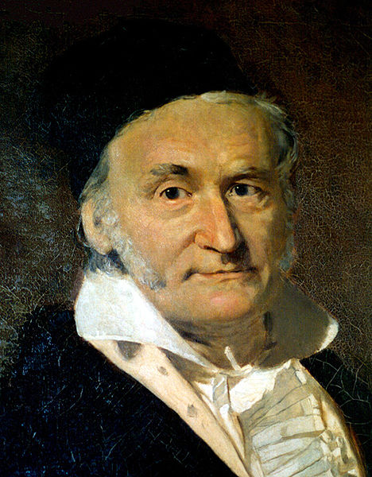

Carl Friedrich Gauss
Carl Friedrich Gauss (1777-1855) was a remarkably influential German mathematician
Started doing groundbreaking math as teenager
Did not invent Normal distribution, but popularized it
He looked more like Martin Sheen
Who is, of course, Charlie Sheen’s father

Slide 13
Anatomy of a beautiful equation
the distance to the mean
“exponential”
probability density at x
sigma shows up twice
a constant

Slide 14
Let’s try and integrate it!
* Call me if you find an equation for this

Slide 15
Four Prototypical Trajectories
No closed form for the integral

Slide 16
Four Prototypical Trajectories
No closed form for F(x)

Slide 17
Spoiler Alert
A function that has been solved for numerically
The cumulative density function of any normal
* We are going to spend the next few slides getting here

Slide 18
Linear Transform of Normal is Normal
If
then Y is also Normal

Slide 19
Special Linear Transform
If
then Y is also Normal
There is a special case of linear transform for any X:

Slide 20
Standard (Unit) Normal Variable
Z is a Standard (or Unit) Normal RV: Z ~ N(0, 1)
E[Z] = m = 0 Var(Z) = s ² = 1 SD(Z) = s = 1
CDF of Z, F_{Z}(z) does not have closed form
We denote F_{Z}(z) as Φ(z): “phi of z”
By symmetry: Φ(–z) = P(Z ≤ –z) = P(Z ≥ z) = 1 – Φ(z)

Slide 21
Symmetry of Phi

Slide 22
Compute F(x) via Transform
Use Z to compute F(x)

Slide 23
And here we are
A function that has been solved for numerically
The cumulative density function of any normal
Table of Φ(z) values in textbook, p. 201 and handout

Slide 24
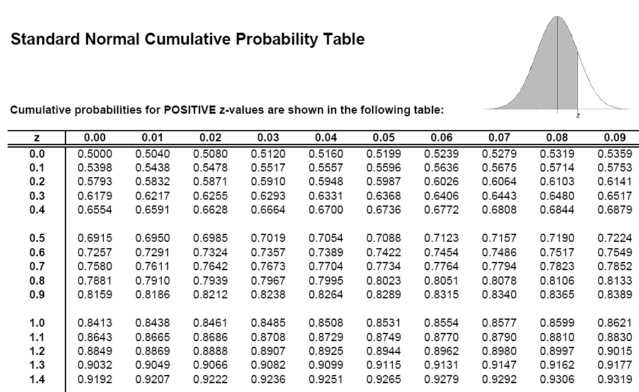
Using Table of ɸ
Φ(0.54) = 0.7054

Slide 25
Four Prototypical Trajectories
Kinda old school

Slide 26
Using Programming Library
norm.cdf(x, mean, std)
* Every modern programming language has a normal library

Slide 27
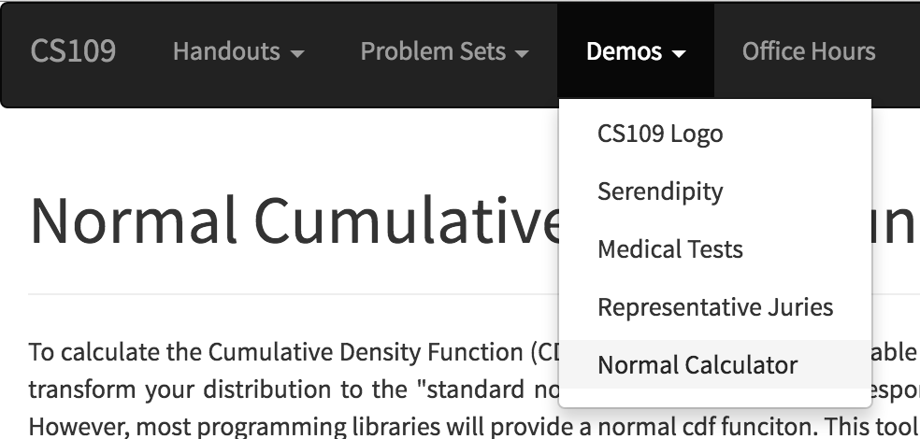
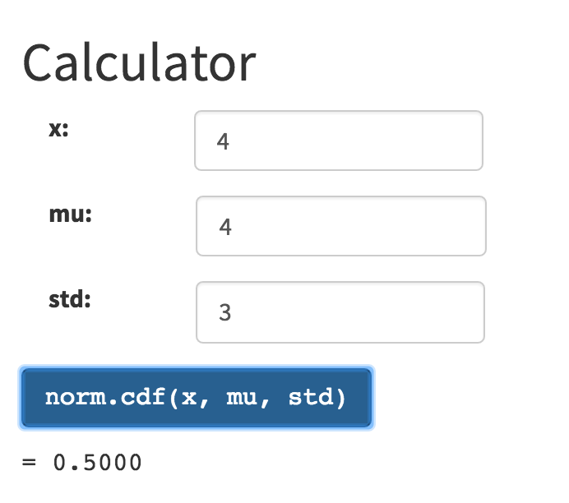
I made one for you

Slide 28
Get Your Gaussian On
X ~ N(3, 16) μ = 3 σ ² = 16 σ = 4
What is P(X > 0)?
What is P(2 < X < 5)?
What is P(|X – 3| > 6)?
0.1337

Slide 29
Noisy Wires
Send voltage of 2 or -2 on wire (to denote 1 or 0)
X = voltage sent
R = voltage received = X + Y, where noise Y ~ N(0, 1)
Decode R: if (R ≥ 0.5) then 1, else 0
What is P(error after decoding | original bit = 1)?
What is P(error after decoding | original bit = 0)?

Slide 30
Four Prototypical Trajectories
Gaussian for uncertainty

Slide 31
ELO Ratings
What is the probability that the Warriors beat the Rockets?
How do you model zero sum games?

Slide 32
ELO Ratings
How it works:
Each team has an “ELO” score S, calculated based on their past performance.
Each game, the team has ability A ~ N(S, 200²)
The team with the higher sampled ability wins.
Arpad Elo
p
1555
1797
ability
Calculated via sampling

Slide 33
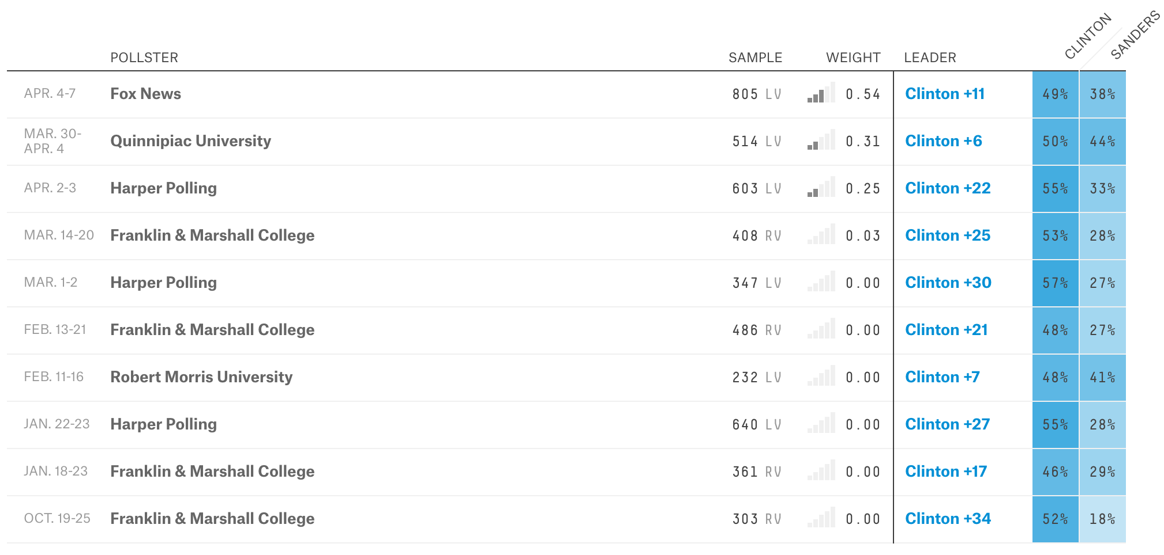
Poll of polls?
Democratic Pennsylvania Primary
Credit: fivethirtyeight.com
What is the probability that Hillary/Bernie wins?

Slide 34
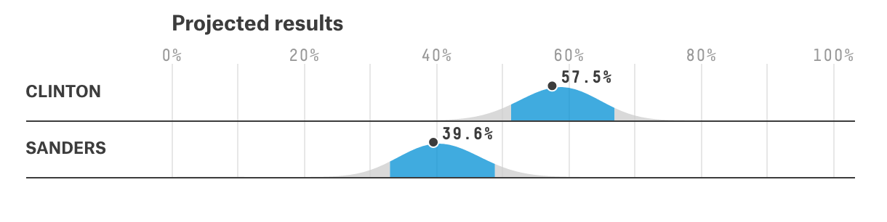
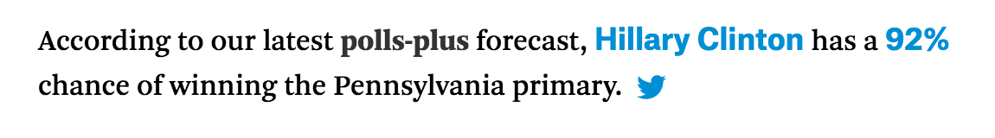
Poll of polls?
Credit: fivethirtyeight.com
How it works:
Estimate a Gaussian for each candidate
Mean is a weighted average of poll means
Variance is a weighted average of poll trust
Sample Gaussians to find out % win
Key: represent uncertainty

Slide 35
Four Prototypical Trajectories
Gaussian for Binomial

Slide 36
Remember this?
There is a deep reason for the Binomial/Normal approximation…

Slide 37
Normal Approximation of Binomial
X ~ Bin(n, p)
E[X] = np Var(X) = np(1 – p)
Poisson approx. good: n large (> 20), p small (< 0.05)
For large n: X ≈ Y ~ N(E[X], Var(X)) = N(np, np(1 – p))
Normal approx. good : Var(X) = np(1 – p) ≥ 10
DeMoivre-Laplace Limit Theorem:
S_{n}: number of successes (with prob. p) in n independent trials
“Continuity correction”

Slide 38
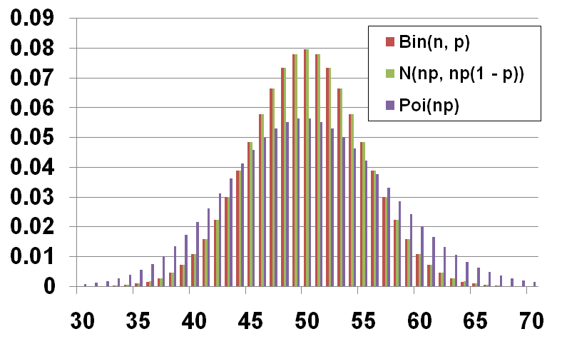
Comparison when n = 100, p = 0.5
P(X = k)
k

Slide 39
Website Testing
100 people are given a new website design
X = # people whose time on site increases
CEO will endorse new design if X ≥ 65 What is P(CEO endorses change| it has no effect)?
X ~ Bin(100, 0.5)
Use Normal approximation: Y ~ N(50, 25)
Using Binomial:

Slide 40
Stanford Admissions
Stanford accepts 2480 students
Each accepted student has 68% chance of attending
X = # students who will attend. X ~ Bin(2480, 0.68)
What is P(X > 1745)?
Use Normal approximation: Y ~ N(1686.4, 539.65)
Using Binomial:

Slide 41
Changes in Stanford Admissions
Stanford Daily, March 28, 2014
“Class of 2018 Admit Rates Lowest in University History” by Alex Zivkovic
“Fewer students were admitted to the Class of 2018 than the Class of 2017, due to the increase in Stanford’s yield rate which has increased over 5 percent in the past four years, according to Colleen Lim M.A. ’80, Director of Undergraduate Admission.”

